Slide 1

Lead Scoring Case Study
Contributors:
Gopika
Nagarjuna
Shwetha

Slide 2
Problem Statement
An education company named X Education sells online courses to industry professionals. On any given day, many professionals who are interested in the courses land on their website and browse for courses.
The company markets its courses on several websites and search engines like Google. Once these people land on the website, they might browse the courses or fill up a form for the course or watch some videos. When these people fill up a form providing their email address or phone number, they are classified to be a lead. Moreover, the company also gets leads through past referrals. Once these leads are acquired, employees from the sales team start making calls, writing emails, etc. Through this process, some of the leads get converted while most do not. The typical lead conversion rate at X education is around 30%.

Slide 3
Business Goal
To make this process more efficient, the company wishes to identify the most potential leads, also known as ‘Hot Leads’. If they successfully identify this set of leads, the lead conversion rate should go up as the sales team will now be focusing more on communicating with the potential leads rather than making calls to everyone

Slide 4
Problem Solving Strategy/ Methodology
Data Cleaning
EDA
Dummy Variables
Train-Test Split
Model Building
Model Evaluation
Prediction
Precision - Recall
Final Analysis/ Suggestion

Slide 5
Data Cleaning
We removed the redundant columns by using nunique function
Removed columns with >30% null values where it doesn’t impact the analysis
Columns that were essential were retained if though the null values were >30% and replaced the null values to ‘Not provided’.

Slide 6
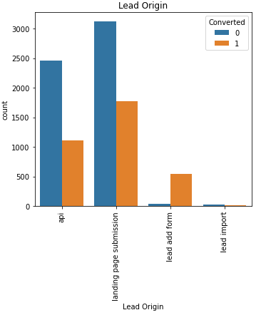
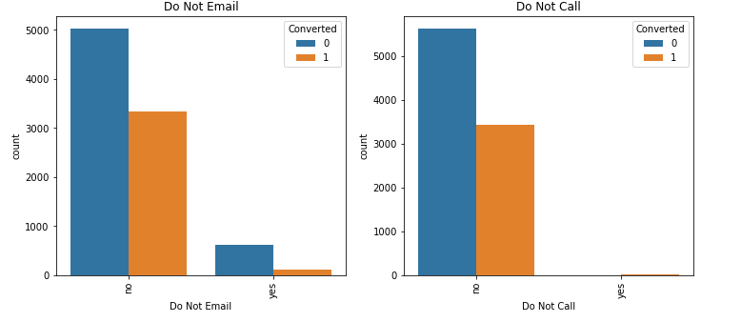
Exploratory Data Analysis (EDA) (1/3)
In Lead Origin, maximum conversion happened from Landing page submission
It was also noticed that emails sent and calls made had a major conversion

Slide 7
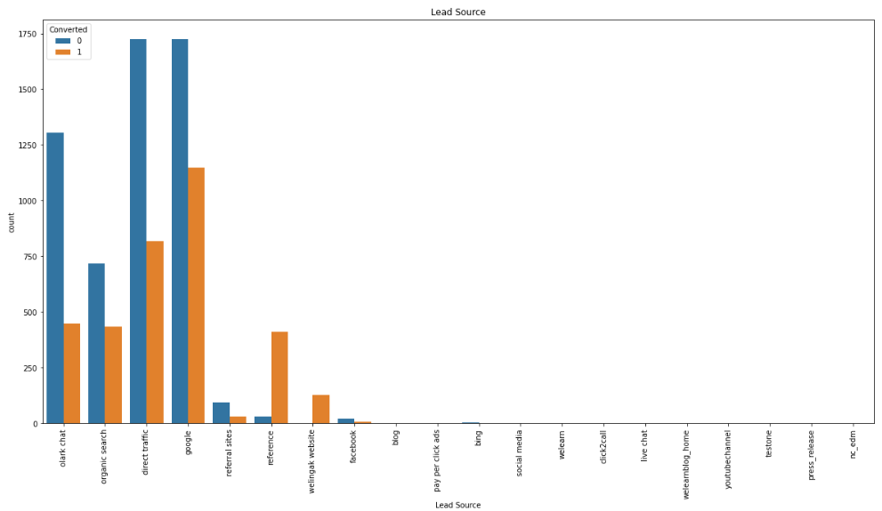
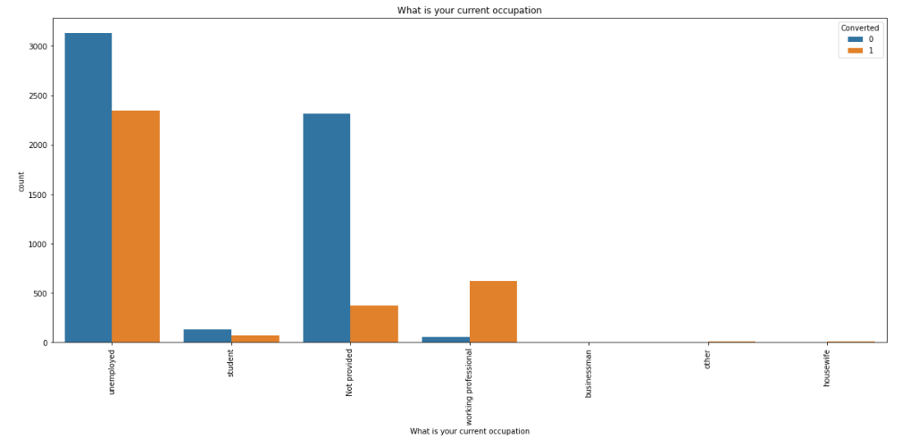
Exploratory Data Analysis (EDA) (2/3)
3. Lead source from google, Direct traffic and Olark chat showed higher conversion rates compared other sources
4. More conversion were noticed with the current occupation type ‘Unemployed’

Slide 8
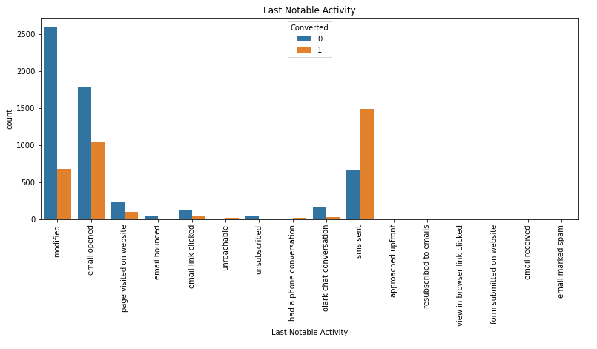
Exploratory Data Analysis (EDA) (3/3)
5. We noticed higher conversion when Last Notable Activity value was ‘SMS sent’

Slide 9
Dummy variables/ Top 15 Variables impacting the Analysis
Total Time Spent on Website
Total Visits
Lead Source_google
Lead Source_direct traffic
Lead Source_organic search
Last Activity_sms sent
Lead Origin_lead add form
Lead Source_welingak website
Do Not Email_yes
What is your current occupation_working professional
Last Notable Activity_unsubscribed
Lead Source_referral sites
Last Activity_olark chat conversation
What is your current occupation_housewife
Last Notable Activity_had a phone conversation

Slide 10
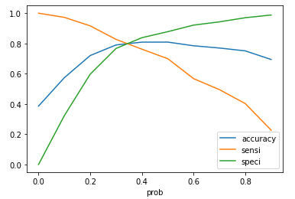
Model Evaluation (Accuracy, Sensitivity and Specificity)
The Graph depicts an optimal cut off of 0.38 based on accuracy, sensitivity and specificity
Accuracy – 80%
Sensitivity – 76%
Specificity – 83%

Slide 11
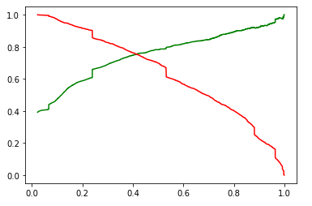
Model Evaluation (Precision & Recall)
The Graph depicts an optimal cut off of 0.41 based on precision and recall
Precision – 78%
Recall – 69%

Slide 12
Final Analysis
The following variables mattered the most in the potential buyers/ Conversions:
The total time spent on the website
Total number of visits
Lead source:
Google
Direct traffic
Olark chat
Organic search
Last activity:
Olark Chat
SMS
Lead origin is Lead add Format
The current Occupation is Working Professional

Slide 13
Suggestion
The sales team should focus more on the profiles matching the criteria stated in the analysis to have maximum conversions and flourish the sales chart.
Make the website more interactive so that the potential buyers who spend more time on website have higher chance of buying the courses
Make the Olark chat process and SMS more engaging to have a higher conversion rate

Slide 14

Thank You!

